Slide 1
Google Authenticator
Scott Wu
2017-Oct-5

Slide 2
Background
T-Mobile has raise the potential requirement to support Google Authenticator in IAM.
Google authenticator is used popularly in Google 2-Steps verification.
Google Authenticator is based on open standardization and used by more and more web sites and applications. It is valuable for IAM to introduce it.

Slide 3

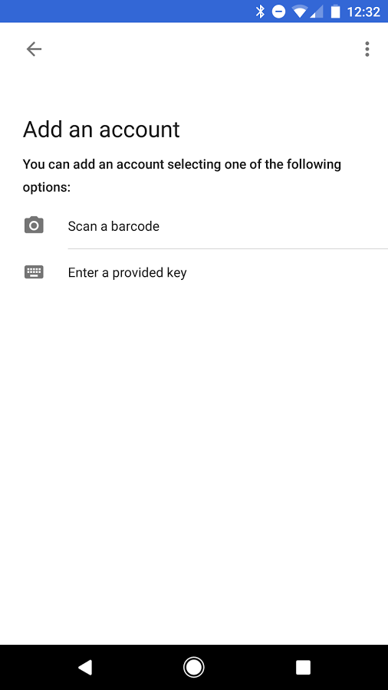
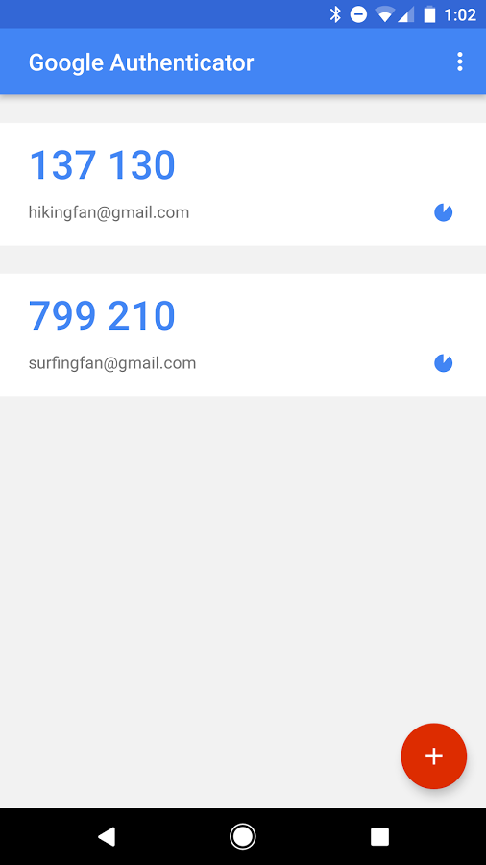
Basic Process
Google provides “Google Authenticator” app to generate one time password.
The user can register his account into “Google Authenticator” app via scanning bar code or input a key.
After scan or input code, the user account is added, and the app can generate one time password per 30 second.

Slide 4
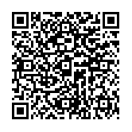
What’s behind the bar code?
To generate a bar code, the user should provide:
issuer: IdP
account: unique identity of the user
Key: a unique share key. Normally it will be generated by IdP.
Example:
{ "issuer":"Ericsson", "account":"scott.wu@ericsson.com", "key":"KATPWZW6UDTIHK6LXGKKTE7ATTVAPQCS“ }
URL behind bar code: otpauth://totp/Ericsson:scott.wu@ericsson.com?secret=KATPWZW6UDTIHK6LXGKKTE7ATTVAPQCS&issuer=Ericsson&algorithm=SHA1&digits=6&period=30
Authenticator app will connect to backend with this URL and starts to generate a new OTP.

Slide 5

Core Knowledge
Shared Key (K)
Both client and server will hold same key. (via input or scan)
Client and server have a mechanism to sync up their counter.
Both client and server will use same algorithm to generate the OTP based on key and counter.
Server
Client/ App
Counter (C)
Counter (C)
Algorithm
Server OTP
Client OTP
Compare

Slide 6
Background Knowledges
Google Authenticator is based on TOTP (Time-based One-Time Password) algorithm which is defined in RFC 6238.
The footstone of TOTP is HMAC-Based One-time Password (HOTP) which is defined in RFC 4226

Slide 7
HOTP Introduction
Terms & Parameters:
Key: shared key. Must be unique.
C: counter (a.k.a. moving factor). 8 bytes value.
Digit : required OTP length. Typically it’s 6 or 8.
T: Throttling Parameter. After T retry, the request will be rejected.
S: Resynchronization parameter. Tell server to move counter forward S times in case the client generated OTP but doesn’t use it.

Slide 8

HOTP Algorithm
K
C
Step 1
HMAC-SHA-1
20 bytes Hex String
0 | 1 | 2 | 3 | 4 | 5 | 6 | 7 | 8 | 9 | 10 | 11 | 12 | 13 | 14 | 15 | 16 | 17 | 18 | 19
1f | 85 | 32 | 4d | 31 | 02 | fe | 61 | 7d | ae | 50 | ef | 7f | 19 | da | dd | ed | 3d | 55 | 5a
Take 4 bytes from 10th byte
5 | a
Step 2
a
0xa
Hex ‘a’ to decimal 10
10
Step 3
Hex to Dec
50 | ef | 7f | 19
1357872921
Step 4
1357872921 MOD${10}^{6}$
Digit = 6
872921

Slide 9
Challenge
Sync up the counters between server and client !!!
Client will increase counter for each generate.
Server will increase its counter for each validation.
Generation times != validation time.

Slide 10
TOTP
TOTP is based on HOTP. The major difference is the counter is changed to use time.
X: time slot. The OTP will be generated per X seconds. Normally it is 30.
T0 : the Unix time to start counting time steps (default value is 0, i.e., the Unix epoch) and is also a system parameter.
Google used 0 as well.

Slide 11
TOTP Flow
TOTP will use time to calculate the counter. It can simplify the counter synchronization logic.
T0
X
Current Timestamp (T)
K
C
Step 1
HMAC-SHA-1
C=(T-T0)/X
20 bytes Hex String
0 | 1 | 2 | 3 | 4 | 5 | 6 | 7 | 8 | 9 | 10 | 11 | 12 | 13 | 14 | 15 | 16 | 17 | 18 | 19
1f | 85 | 32 | 4d | 31 | 02 | fe | 61 | 7d | ae | 50 | ef | 7f | 19 | da | dd | ed | 3d | 55 | 5a
Time sync is quite important!

Slide 12
Pseudocode for event or counter OTP
function GoogleAuthenticatorCode(string secret)
key := base32decode(secret)
message := counter encoded on 8 bytes
hash := HMAC-SHA1(key, message)
offset := last nibble of hash
truncatedHash := hash[offset..offset+3] //4 bytes starting at the offset
Set the first bit of truncatedHash to zero //remove the most significant bit
code := truncatedHash mod 1000000
pad code with 0 until length of code is 6
return code

Slide 13
Security
Scenarios | Result
The counters in server and client are synchronized. | The OTP generated by client can be validated in server successfully. Both client counter and server counter are increase.
Client generated multiple OTPs, but didn’t send to server. | Client counter was increased by N. Server counter is not changed. (out-of-sync). Server should try to ‘look ahead’ to match received OTP by move counter ‘S’ times. Eventually failure will cause reset. (re-scan or re-input key)
Client inputs multiple invalid OTPs | If the failures exceeds the threshold (T), the account will be regarded as ‘under risk’.

Slide 14
Q&A

